Slide 1
基于可信环境的身份鉴别方案
网络认证技术

Slide 2
移动终端的身份鉴别问题
智能移动终端访问网络服务
用户名/口令频繁输入，存在安全风险
……
解决方案
用户在移动终端尽量少使用用户名/口令
如何实现?
移动终端记住用户的用户名/口令？
使用统一身份认证/单点登录？
用户只需在一个服务中输入用户名/ 口令，无需在多个应用处到处输入用户名/口令
统一认证解决的问题是，避免多个应用具有不同的安全性，导致用户信息受到安全性威胁
这里的问题是，在互联网环境中使用口令的安全风险，包括移动终端、网络传输等方面

Slide 3
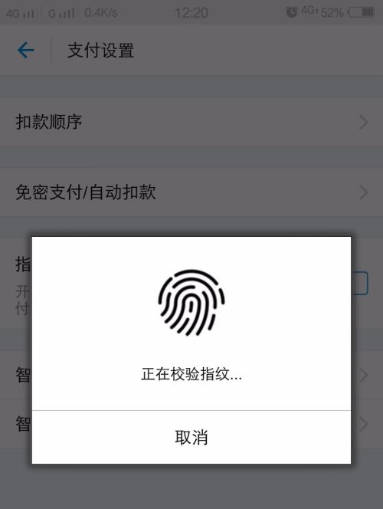
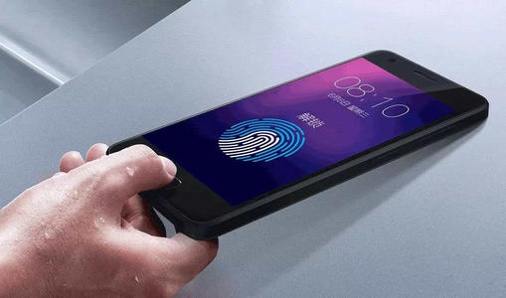
基于移动终端可信环境的身份鉴别
在服务器端将用户与移动终端的可信环境进行身份绑定
将用户与服务器之间的直接鉴别转变为两段式鉴别
1. 移动终端鉴别用户
本地免密难验证，生物特征识别
2. 网络服务鉴别移动终端
问题：
用口令存在安全隐患，改用其它的身份鉴别方式不可以吗？
比如，生物特征、USBKey
为什么要用两阶段式方案？

Slide 4
基于移动终端可信环境的身份鉴别
在服务器端将用户与移动终端的可信环境进行身份绑定
将用户与服务器之间的直接鉴别转变为两段式鉴别
1. 移动终端鉴别用户
本地免密难验证，生物特征识别
2. 网络服务鉴别移动终端
国家标准
GB/T 36651—2018 信息安全技术 基于可信环境的生物特征识别身份鉴别协议框架
典型方案
FIDO
IFAA
……

Slide 5
What is FIDO?
Fast Identity Online(FIDO)
The FIDO protocols use standard public key cryptography techniques to provide stronger authentication.FIDO 协议使用标准的公钥加密技术来提供更强的身份验证功能。
FIDO Alliance
2013年2月正式成立，由6家创始人单位发起，联想是其中之一。

Slide 6
What is FIDO?
There are three key protocols included in the FIDO architecture.
UAF(Universal Authentication Framework)
U2F(Universal 2nd Factor)
CTAP(Client to Authenticator Protocols )
Versions
FIDO 1.0 2014.12
FIDO 2.0 2019.01
Expended with WebAuthn & CTAP
WebAuthn enables online services to use FIDO Authentication through a standard web API that can be built into browsers and related web platform infrastructure.
CTAT(Client to Authenticator Protocol ) enables external devices such as mobile handsets or FIDO security keys to work with browsers supporting WebAuthn.

Slide 7
What is FIDO?
UAF(Universal Authentication Framework)
The UAF protocol allows online services to offer password-less and multi-factor security.
The user registers their device to the online service by selecting a local authentication mechanism.
such as swiping a finger, looking at the camera, speaking into the mic, entering a PIN, etc.
The user simply repeats the local authentication action whenever they need to authenticate to the service.
UAF also allows experiences that combine multiple authentication mechanisms such as fingerprint + PIN.

Slide 8
What is FIDO?
U2F(Universal 2nd Factor)
The U2F protocol allows online services to augment the security of their existing password infrastructure by adding a strong second factor to user login.
The user logs in with a username and password as before. The service can also prompt the user to present a second factor device at any time it chooses.
The strong second factor allows the service to simplify its passwords (e.g. 4-digit PIN) without compromising security.
During registration and authentication, the user presents the second factor by simply pressing a button on a USB device or tapping over NFC.
The user can use their FIDO U2F device across all online services that support the protocol leveraging built-in support in web browsers.

Slide 9
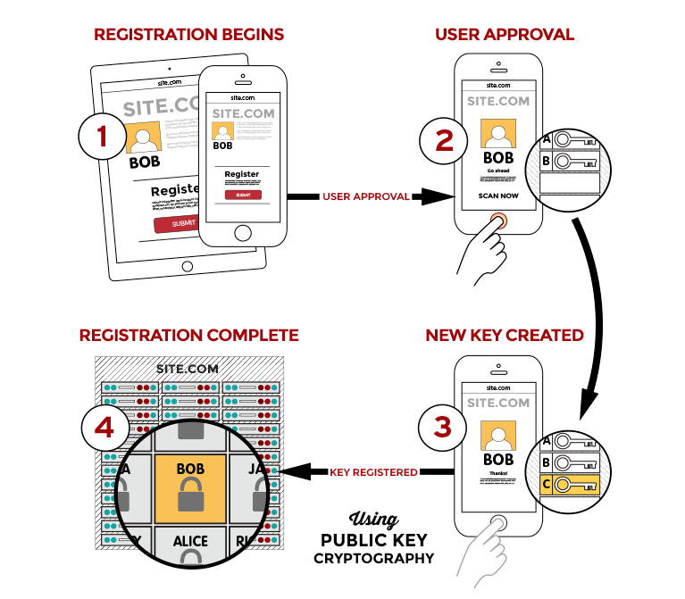
How does FIDO work?
User is prompted to choose an available FIDO authenticator that matches the online service’s acceptance policy.
User unlocks the FIDO authenticator using a fingerprint reader, a button on a second–factor device, securely–entered PIN or other method.
User’s device creates a new public/private key pair unique for the local device, online service and user’s account.
Public key is sent to the online service and associated with the user’s account. The private key and any information about the local authentication method (such as biometric measurements or templates) never leave the local device.
Registration

Slide 10
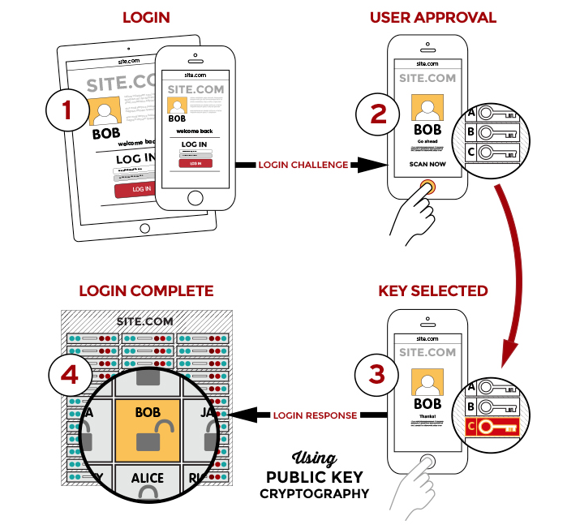
How does FIDO work?
Login
Online service challenges the user to login with a previously registered device that matches the service’s acceptance policy.
User unlocks the FIDO authenticator using the same method as at Registration time.
Device uses the user’s account identifier provided by the service to select the correct key and sign the service’s challenge.
Client device sends the signed challenge back to the service, which verifies it with the stored public key and logs in the user.

Slide 11
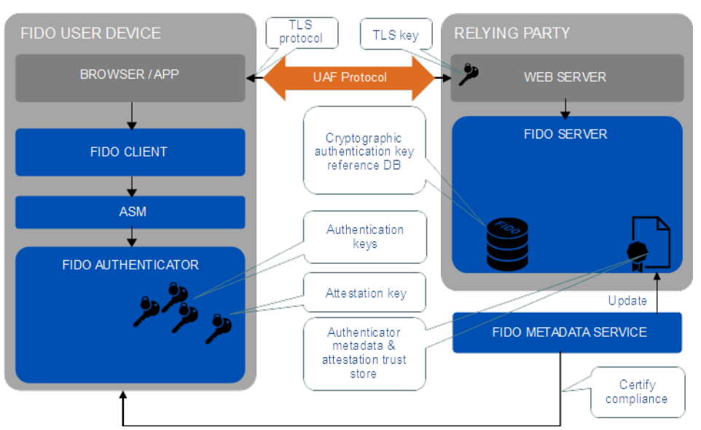
UAF Architecture
Notes:
UAF Authenticator-specific Module API: Authenticator-specific Module API provided by an ASM to the FIDO client.
ffff
基本就是前面的原理

Slide 12
UAF Architecture
Secure Communication
In order to protect the data communication between FIDO UAF Client and FIDO Server a protected TLS channel must be used by FIDO UAF Client (or User Agent) and the Relying Party for all protocol elements.

Slide 13
UAF Architecture
UAF Server(FIDO Server)
implements the server side of the FIDO UAF protocols
interacts with the Relying Party web server to communicate FIDO UAF protocol messages to a FIDO UAF Client
manages the association of registered FIDO UAF Authenticators to user accounts at the Relying Party
evaluates user authentication and transaction confirmation responses to determine their validity

Slide 14
UAF Architecture
UAF Client
the software entity processing the UAF protocol messages on the FIDO User Device
interacts with specific FIDO UAF Authenticators
interacts with a user agent on the device (e.g. a mobile app, browser)
two forms:
A software component implemented in a user agent (either web browser or native application).
A standalone piece of software shared by several user agents. (web browsers or native applications).

Slide 15
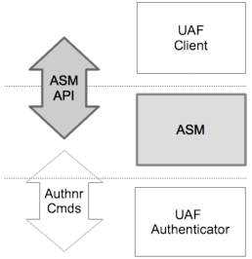
UAF Architecture
ASM / Authenticator Specific Module
Software associated with a FIDO Authenticator that provides a uniform interface between the hardware and FIDO Client software.

Slide 16
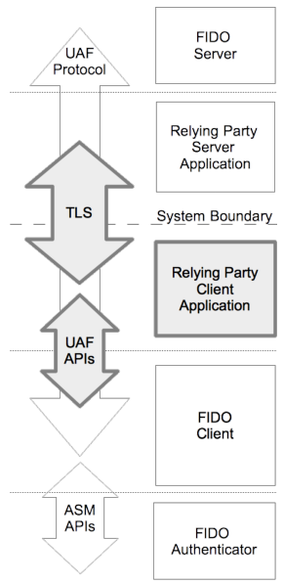
UAF Architecture

Slide 17
UAF Architecture
UAF Authenticator
An authentication entity that meets the FIDO Alliance’s requirements and which has related metadata.
A secure entity, connected to or housed within FIDO user devices.
Be responsible for user verification, and maintaining the cryptographic material required for the relying party authentication.
creates key material associated to a Relying Party
For example, the FIDO UAF Authenticator can provide a response to a cryptographic challenge using the key material thus authenticating itself to the Relying Party.

Slide 18
UAF Architecture
Some examples of UAF Authenticators:
A fingerprint sensor built into a mobile device
PIN authenticator implemented inside a secure element
A mobile phone acting as an authenticator to a different device
A USB token with built-in user presence verification
A voice or face verification technology built into a device

Slide 19
UAF Architecture-Authenticator
There are four types of authenticators
First-factor Bound Authenticator:These authenticators have an internal matcher.
Second-factor (2ndF) Bound Authenticator:This type of authenticator is similar to first-factor bound authenticators, except that it can operate only as the second-factor in a multi-factor authentication
First Factor (1stF) Roaming Authenticator must have an internal storage for key handles
Second-factor Roaming Authenticator can store their key handles on an associated server, in order to avoid the need for internal storage.
Bound authenticators are typically embedded into a user's computing device and thus can utilize the host's storage for their needs. Trusted Execution Environments (TEE), Secure Elements and Trusted Platform Modules (TPM) are typically designed in this manner.

Slide 20
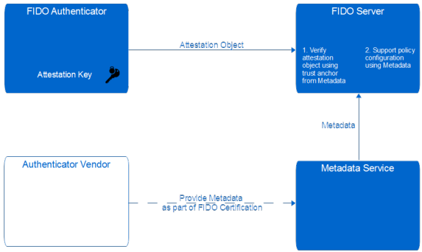
UAF Architecture—MDS
FIDO Metadata Service (MDS)
is a web-based tool where FIDO authenticator vendors can publish metadata statements for FIDO servers to download
provides organizations deploying FIDO servers with a centralized and trusted source of information about FIDO authenticators

Slide 21

UAF Architecture—MDS
FIDO Certification
FIDO Alliance manages functional certification programs for its core specifications (UAF, U2F and FIDO2) to validate product conformance and interoperability
https://fidoalliance.org/certification/fido-certified-products/
A FIDO Server only accept Authenticators with FIDO Certified.

Slide 22
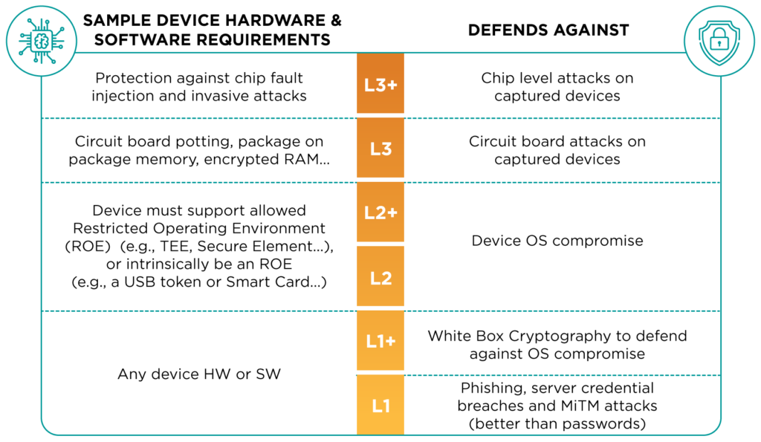
FIDO Certification
Authenticator Levels

Slide 23
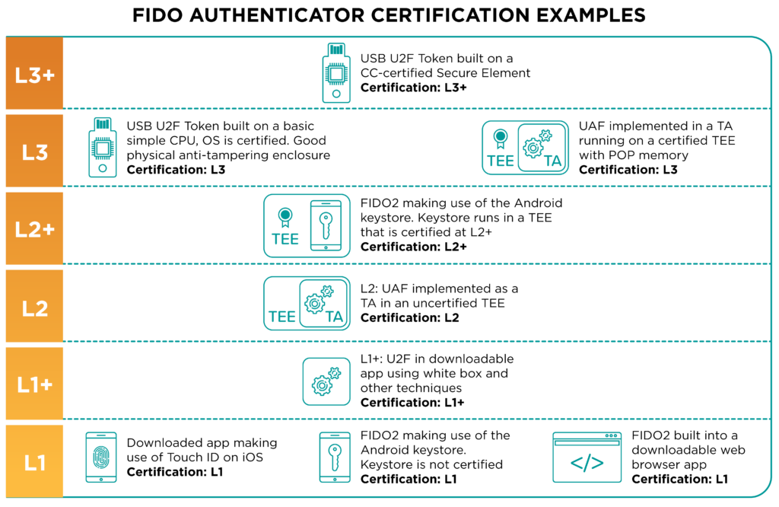
FIDO Certification
Authenticator Levels

Slide 24
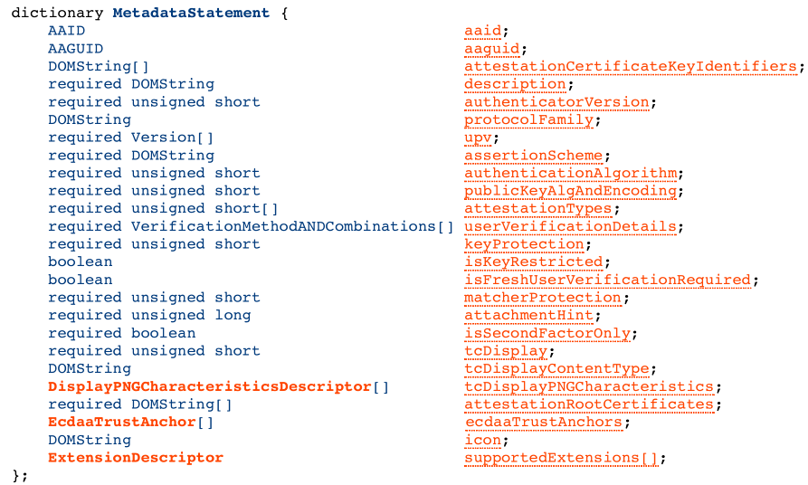
UAF Architecture—MDS
Authenticator 标识
Attestation 公钥

Slide 25
UAF Architecture-MDS
AAID(authenticator Attestation ID)
Each authenticator must have an AAID to identify UAF enabled authenticator models globally.
The AAID must uniquely identify a specific authenticator model within the range of all UAF-enabled authenticator models
authenticators of a specific model must share identical security characteristics within the model
The AAID is a string with format "V#M", where
"V" indicates the authenticator Vendor Code
"M" indicates the authenticator Model Code
The FIDO Alliance is responsible for assigning authenticator vendor Codes
Authenticator vendors are responsible for assigning authenticator model codes

Slide 26
UAF Protocol
FIDO UAF messages between user devices and Relying Parties
Authenticator Registration
User Authentication
Secure Transaction Confirmation
Authenticator Deregistration

Slide 27
Version Negotiation
The UAF protocol includes multiple versioned constructs: UAF protocol version, the version of Key Registration Data and Signed Data objects (identified by their respective tags), and the ASM version.
The FIDO UAF Client must select the authenticators which will generate the appropriately versioned constructs.

Slide 28
Authenticator Registration

Slide 29
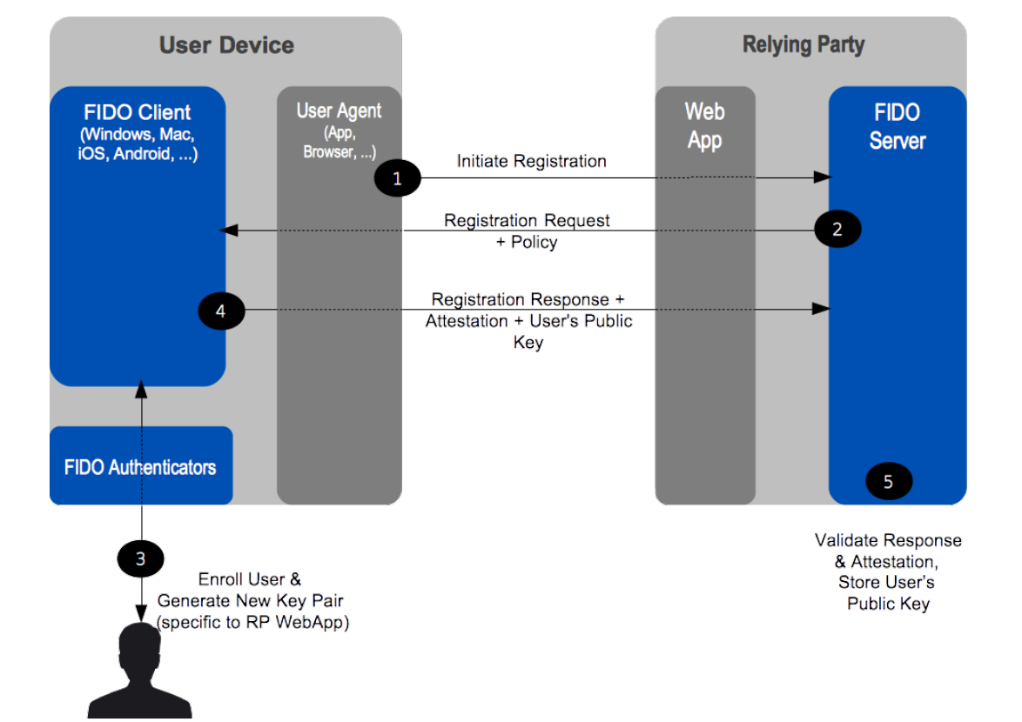
Authenticator Registration

Slide 30
User Enrollment—Before registration
A user must go through an authenticator-specific enrollment process.
For example, in the case of a fingerprint sensing authenticator, the user must register their fingerprint(s) with the authenticator.
Once enrollment is complete, the FIDO UAF Authenticator is ready for registration with FIDO UAF enabled online services and websites.
The enrollment process is outside the scope of the FIDO UAF protocol.

Slide 31
用户登录APP/Service
选定authenticator,发起注册请求

Slide 32
Authenticator Registration
Policy-选择Authenticator
Contains a specification of accepted authenticators and a specification of disallowed authenticators.
represents ordered preferences by the server.
Servers must put their preferred authenticators first.
FIDO UAF Clients should respect those preferences, either by presenting authenticator options to the user in the same order, or by offering to perform the operation using only the highest-preference authenticator(s).
FIDO UAF Clients
Filter available authenticators with the given policy and present the filtered list to User.
Let the user select the preferred Authenticator.

Slide 33
AppID& FacetID
AppID
An identifier for a set of different Facets of a relying party's application.
A URL pointing to the TrustedFacets, i.e. list of FacetIDs related to this AppID.
Each key created by the authenticator is associated with an AppID.
By default, the audience of the credential is restricted to the Same Origin of the AppID.
https://www.example.com/appID

Slide 34
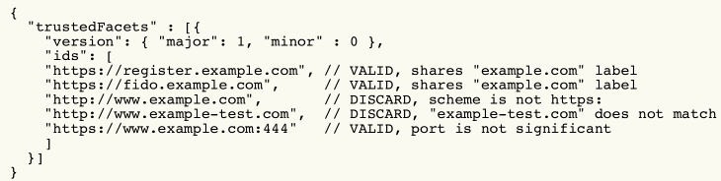
AppID& FacetID
Facet
An (application) facet is how an application is implemented on various platforms.
For example, the application MyBank may have an Android app, an iOS app, and a Web app. These are all facets of the MyBank application.
Application Facet ID
is a platform-specific identifier (URI) for an application facet.
A Relying Party can declare the application identities allowed to access its registered keys using a TrustedFacetList that designates a scope or audience restriction.
"https://www.example.com/appID" is provided as an AppID
Notes:
The facetID is determined by the FIDO UAF Client and verified against the list of trusted facets retrieved
by dereferencing the appID of the calling application.

Slide 35
为用户在某APP/Service的账号绑定authenticator及特定的公钥

Slide 36
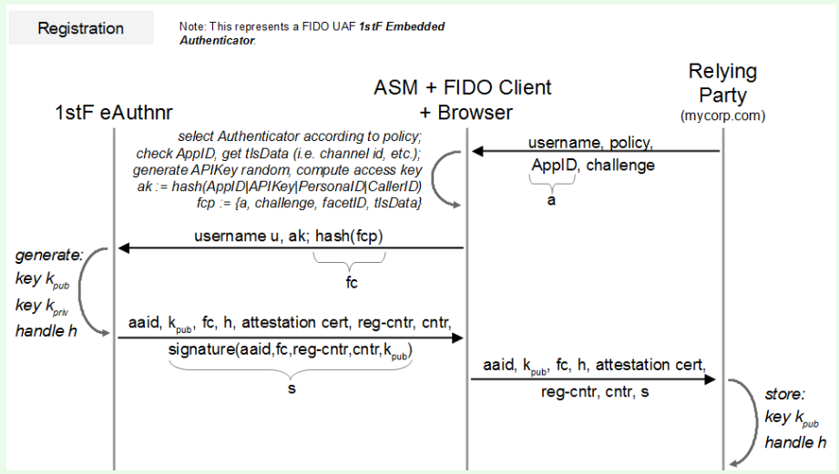
KHAccessToken
UAF Registration Cryptographic Data Flow

Slide 37
KHAccessToken
FIDO Authenticators are capable of binding UAuth.Key with a key provided by the caller (i.e. the ASM). This key is called KHAccessToken.
It is based on a Trust On First Use (TOFU) concept.
It allows restricting access to the keys generated by the FIDO Authenticator to the intended ASM.
This technique allows making sure that registered keys are only accessible by the caller that originally registered them. A malicious App on a mobile platform won't be able to access keys by bypassing the related ASM.
It is typically specific to the AppID, PersonaID, ASMToken and the CallerID.
an ASMToken is a random unique ID for the ASM, such as APIKey

Slide 38

PersonaID
PersonaID(Optional)
used to identify the persona in use by the authenticator
FIDO supports unlinkability of accounts at different relying parties by using relying party specific keys.
Sometimes users have multiple accounts at a particular relying party and even want to maintain unlinkability between these accounts.
All relevant data in an authenticator are related to one Persona (e.g. "business" or "personal").
Typically a different PersonaID is assigned to every operating system user account.
An authenticator designed for multi-user systems will likely have to support it.

Slide 39
CallerID
CallerID
is the ID the platform has assigned to the calling FIDO UAF Client.
On different platforms, the CallerID can be obtained differently.
Notes:
(e.g. "bundle ID" for iOS)

Slide 40
Trust on first use
UAF Registration Cryptographic Data Flow

Slide 41
Key Handle
A key container created by a FIDO Authenticator, containing a private key and (optionally) other data (such as Username).
A key handle may be wrapped (encrypted with a key known only to the authenticator) or unwrapped.
Types of Authenticator | Storage of KeyHandle
first-factor Bound Authenticator | Authenticator doesn't store key handles. Instead KeyHandle is always returned to ASM and stored in ASM database.
2ndF Bound Authenticator
first-factor Roaming Authenticator | Authenticator stores key handles inside its internal storage. KeyHandle is never returned back to ASM.
2ndF Roaming Authenticator | Neither Authenticator nor ASM store key handles. Instead KeyHandle is sent to the Server and stored in User's record.

Slide 42
UAF Registration Cryptographic Data Flow

Slide 43
Counters in Registration Response
UAF specifies a Signature Counter.
This counter is increased by every signature operation.
If a cloned authenticator is used, then the subsequent use of the original authenticator would include a signature counter lower to or equal to the previous (malicious) operation.
Such an incident can be detected by the FIDO Server.

Slide 44
Counters in Registration Response
Registration Counter
used as anti-fraud signal
incremented on each registration and hence might become exceedingly high in such fraud scenarios.
Example of committing fraud:
Notes:
Authenticators might support a Registration Counter ( RegCounter ). The RegCounter will be incremented on each registration and hence
might become exceedingly high in such fraud scenarios. See [UAFAuthnrCommands] for more details.

Slide 45
UAF Registration Cryptographic Data Flow

Slide 46
Signature of Registration Response
Registration Response is singed by authenticator’s attestation key.
Attestation Key
A key used for FIDO Authenticator attestation.
Attestation Root Certificate
A root certificate explicitly trusted by the FIDO Alliance, to which Attestation Certificates chain to.
An attestation is how Authenticators make claims to a Relying Party that the keys they generate……

Slide 47
注册响应验证

Slide 48
注册响应验证
Attestation certificate证书链验证
KRD签名验证
Counters检查
验证challenge
应该是FIDO server之前发出的
防重放攻击
KRD
UAF Registration Cryptographic Data Flow

Slide 49
Authenticator Authentication

Slide 50
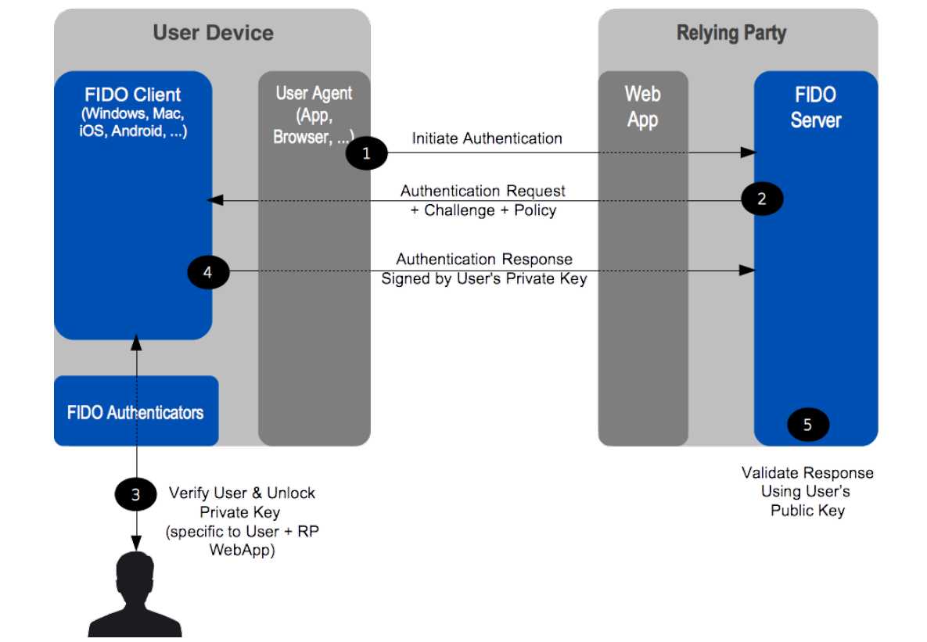
Authenticator Authentication

Slide 52
UAF Authentication Cryptographic Data Flow

Slide 53
Access Control of Authenticator
Command | First-factor Bound | 2ndF Bound | First-factor Roaming | 2ndF Roaming
Register | UserVerify | UserVerify | UserVerify | UserVerify
Sign | UserVerify KHAcessToken KeyHandleList | UserVerify KHAcessToken KeyHandleList | UserVerify KHAcessToken | UserVerify KHAcessToken KeyHandleList
Deregister | KHAcessToken KeyID | KHAcessToken KeyID | KHAcessToken KeyID | KHAcessToken KeyID

Slide 54
鉴别响
应验证

Slide 55
鉴别响应验证
fcp中的每一项
签名验证
利用本地的AAID&相应的公钥进行签名验证
UAF Authentication Cryptographic Data Flow

Slide 56
Transaction Confirmation
In the situation in which a Relying Party wants the end-user to confirm a transaction (e.g. financial operation, privileged operation, etc), FIDO provides "secure transaction" .
Basically if a FIDO UAF Authenticator has a transaction confirmation display capability, FIDO UAF architecture makes sure that the system supports What You See is What You Sign mode (WYSIWYS).

Slide 57
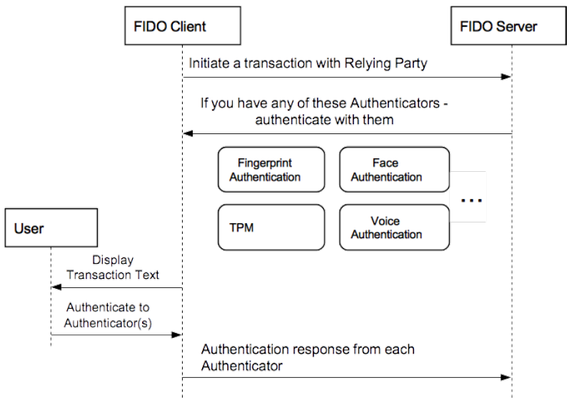
Transaction Confirmation

Slide 59
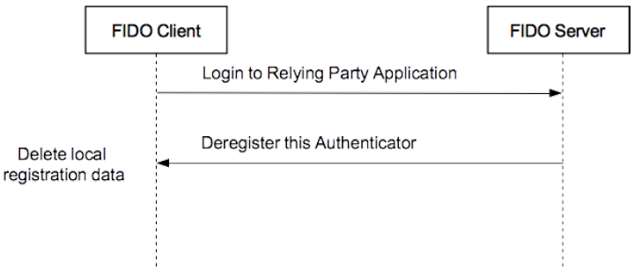
Deregistration
This operation allows FIDO Server to ask the FIDO Authenticator to delete keys related to the particular relying party.

Slide 60
Deregistration

Slide 61
FIDO设备丢失怎么办？
如果RP支持绑定FIDO前的原始身份鉴别方案
继续使用原始的身份鉴别方案登录
是否能重新绑定新的设备，得看RP的具体实现方式及管理策略
如果RP不再支持原始身份鉴别方案
账号就不能再使用了
即使设备没丢失，在未解绑设备之前，只能通过已绑定访问设备访问相应的账号，其他设备都不能再登录

Slide 62
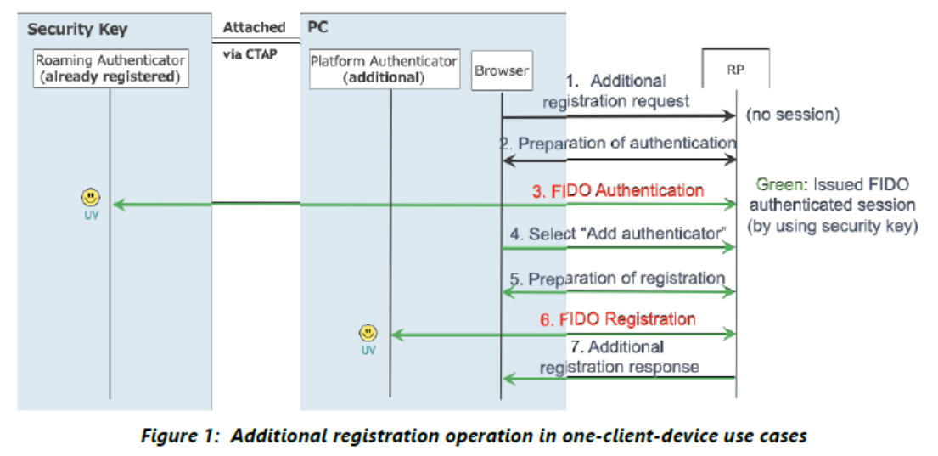
多个FIDO设备的绑定支持
FIDO Alliance White Paper：Multiple Authenticators for Reducing Account-Recovery Needs for FIDO-Enabled Consumer Accounts- 2020

Slide 63
FIDO U2F基本原理
U2F，全称为通用第二因素协议（Universal 2nd Factor Protocol）。在兼容现有在密码验证体系的基础上，当用户进行在线高安全操作时，FIDO提供U2F设备作为第二身份验证因素，完成强安全级别身份验证，提升用户的信息安全，整个交易不受传统密码的强弱影响。
U2F类似国内的二代U盾的保护机制，使用双因子（密码和能与用户交互的设备）保护用户账户和隐私。用户在注册阶段，使用服务器支持的加密设备，将账户和设备绑定。当进行登录验证操作时，服务器在合适的时候，提示用户插入设备并进行按键操作，加密设备对数据签名，发送给服务器，服务器做验证，如果验证成功，用户则可登录成功。由于有了第二因子（加密设备）的保护，用户可以选择不设置密码或者使用一串简单易记的4位密码。

Slide 64
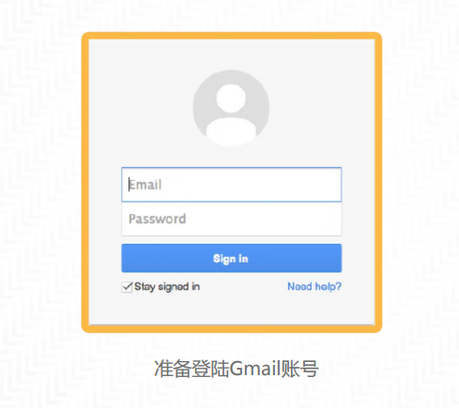
FIDO U2F认证示例-Step 1

Slide 65
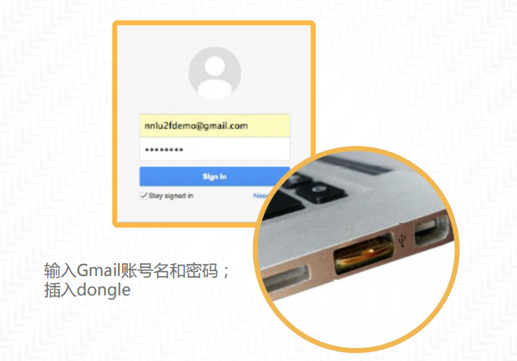
FIDO U2F认证示例-Step 2

Slide 66
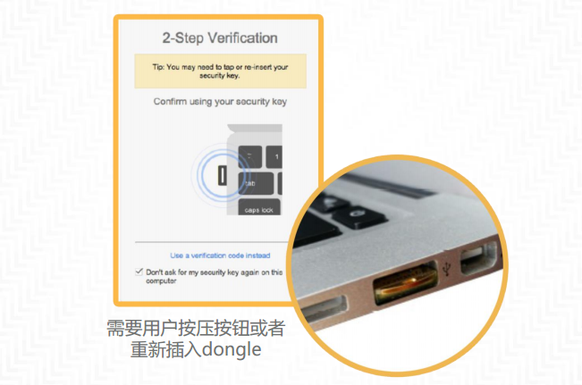
FIDO U2F认证示例-Step 3

Slide 67
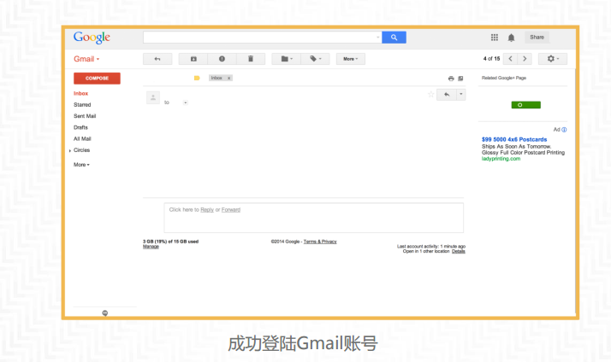
FIDO U2F认证示例-Step 4

Slide 68
U2F设备注册
在拥有一个U2F设备后，用户在客户端(如网页或应用软件)通过原有的用户名与密码登录，确认该站点是否支持U2F协议，如支持即可在网站发起将该U2F设备作为第二身份验证因素的注册申请。
申请通过后，后台服务器响应由协议、主机名以及端口号等网站标识信息生成的HASH值；本地客户端收到响应后提示用户出示U2F设备，并将该HASH值推送给U2F设备。
U2F设备取得用户批准后，基于收到的HASH值，为当前用户在该网站生成一个唯一的公私钥对与一个私钥索引，并将该公钥与私钥索引发给服务器。
服务器在验证收到的公钥信息并保存，并用作后续交易的第二身份验证要素。

Slide 69
U2F设备 | 浏览器 | 服务器
 | 用户输入用户名和密码，点击“注册”，提交给服务器
 |  | 服务器组织注册数据Registration Data，如果提交的用户名已经在服务器注册，服务器还需要组织签名数据Sign Data，将数据发送给客户端
 | 浏览器收到Registration Data 和 Sign Data。给U2F设备发送获取版本命令
接受获取版本APDU指令，返回版本字符串"U2F_V2".
 | 1.判断版本号。 2.判断用户是否已经注册，若已注册，给U2F发送签名指令。 通过U2F设备验证此账号信息是否和U2F设备中保存的信息一致。
U2F设备验证Key Handle是否存在设备中，Key Handle和 application id 是否匹配。如果验证成功，表面设备已经注册
 | 1.如果U2F验证通过，浏览器提示用户账户已注册。 2.如果用户未注册，组织注册数据，给U2F发送注册指令。
U2F设备产生一对密钥对，用私钥对SHA2(Client Data) + SHA2(app_id) 做签名， 返回的数据：公钥+Key Handle+X509证书+签名值。
 | 浏览器将U2F返回的值，Client Data等信息传给服务器。
 |  | 服务器验证证书有效性，组织签名数据，使用对应的公钥做验签操作，验签成功，服务器将账户信息和公钥，Key Handle等信息关联在一起。

Slide 70
U2F身份鉴别
当用户通过已有的用户名和密码登陆后，在进行任何高安全属性的操作（如支付确认、用户信息修改、文件修改删除等）需要用户身份强验证时，后台服务器响应服务器Hash值（见上一步）与用于身份验证的待签名数据，并通过用户客户端推送给已注册的U2F设备；
U2F设备验证服务器Hash值与注册时提供的Hash值是否相同，如相同则进行下一步，如不同，则不响应；
U2F设备在经用户按键确认后，依据Hash计算的私钥索引找到对应私钥对数据签名，并将签名数据通过用户客户端发送给后台服务器；
收到签名数据后，后台服务器找到该用户名对应的公钥，如解密验签通过，完成对用户身份的第二因素验证，批准相关操作；反之，用户身份验证不成功，拒绝本次用户操作。

Slide 71
U2F设备 | 浏览器 | 服务器
 | 用户输入用户名和密码，点击"登陆"，提交给服务器。
 |  | 服务器组织认证数据： Sign Data将数据发送给客户端
 | 浏览器收到Sign Data。给U2F设备发送获取版本命令
接受获取版本APDU指令，返回版本字符串"U2F_V2".
 | 1.判断版本号。 2.组织认证数据，给U2F发送认证指令。主要认证数据为： SHA2(Client Data) + SHA2(app_id)+Key Handle.
U2F设备验证Key Handle是否存在设备中，Key Handle和 application id 是否匹配。如果验证成功，通过Key Handle对应的私钥对指定数据做签名，对应密钥对的引用计数器加一，返回值中数据包括引用计数和签名值。
 | 浏览器将U2F返回的值，Client Data等信息传给服务器。
 |  | 服务器验证引用计数，判断设备是否被克隆，验证Client Data数据合法性，组织签名数据，使用对应的公钥做验签操作，验签成功，服务器将账户的引用计数更新为最新的引用计数。服务器允许用户登录。

Slide 72
FIDO的特点
通用性：国际工业标准，统一的后台服务可以适配所有支持FIDO的智能终端设备。
安全性：
隐私保护，生物特征信息及其产生的私钥保存在手机硬件可信环境之中，不上传到云端；
硬件级安全保障，采用可信执行环境(TEE)或安全芯片执行关键操作及安全存储密钥，保证安全隔离；
网路安全通信，会话数据采用SSL/TLS加密，有效抵制网络窃听；
终端设备验证，设备认证器预置验证私钥，可由服务端进行验签，确保设备本身的合法性。

Slide 73
安全问题
Attestation Key
FIDO的安全性依赖与对Authenticator的信任
同一厂商、同一型号的Authenticator具有相同的attestation key
其本意是为了减少用户信息泄露
一旦一个终端出现问题，其他具有相同Authenticator的终端设备也可能受到影响

Slide 74
How to use FIDO with OIDC
?
RP
End User
OIDC Provider
FIDO Client
FIDO Server

Slide 75
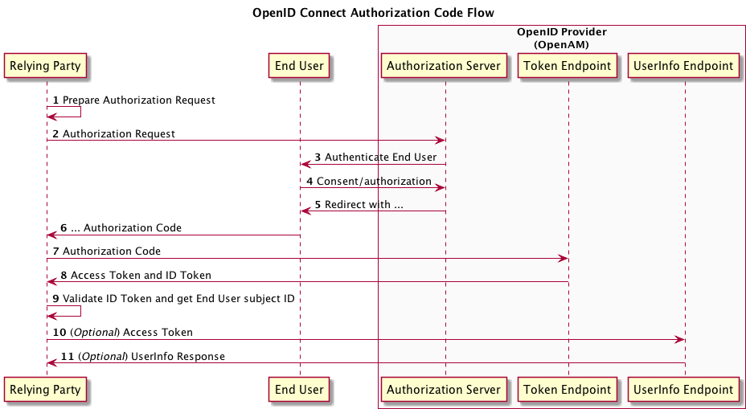
OIDC协议

Slide 76
How to use FIDO with OIDC
End User
(With FIDO Client)
至此完成End User在IDP的身份鉴别，后续进一步完成IDP协议

Slide 77
The End！

